Slide 1
Swagger API
Spring Security
API Gateway 9090
Login & Registration 8081
MySQL Database
Booking 8082
Cab Search 8083
Cab Search 8086
UI Framework
Payment 8084
Driver 8085

Slide 2
User Interface
Service Application Layer
Database
Payment Service Application Layer
Database
User Interface
Service Application Layer
Database

Slide 3
UI Framework with Material Design Template
Implementation of Routing
Implementation of Components
How to you have Implementation various templates

Slide 4
Database
Creating Default Scripts

Slide 5
Example - 2

Slide 6
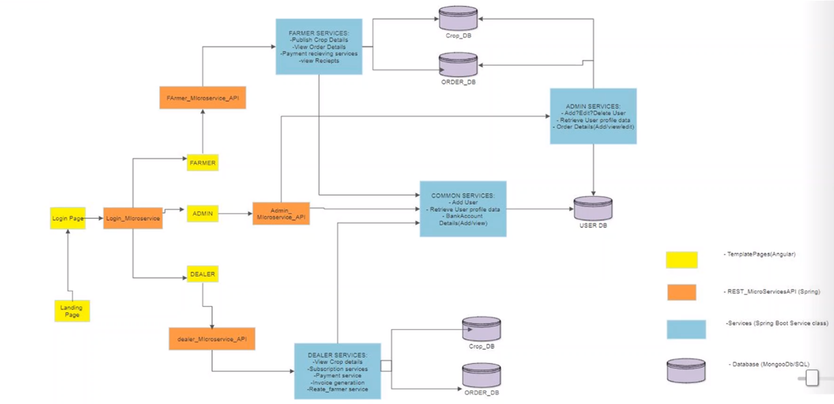

Slide 7
Example - 3

Slide 8
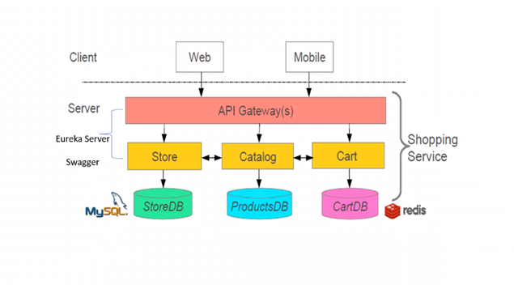

Slide 9
Example - 4

Slide 10
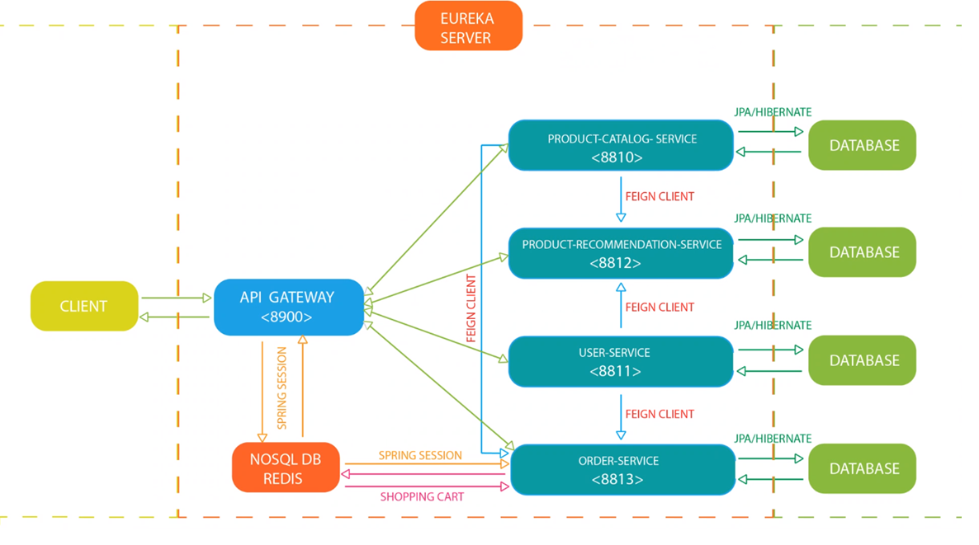

Slide 11
Example - 5

Slide 12
